Slide 1
DEVNET CERTIFICATION TIPS TO COMPLETE MODULE 1

Slide 2
AGENDA
1.1.2 Lab - Install the Virtual Machine Lab Environment – ILM
1.2.2 Lab - Linux Review – ILM
1.3.3 Lab - Python Programming Review - ILM

Slide 3
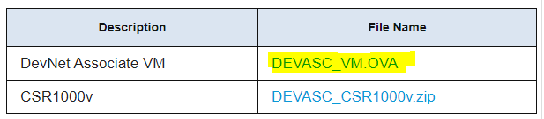
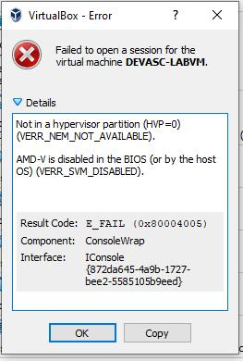
1.1.2 Lab - Install the Virtual Machine Lab Environment – ILM
To complete the first module 1.1.2 Lab - Install the Virtual Machine Lab Environment – ILM you might need the below links:
To download the DEVASC VM: https://itexamanswers.net/devnet-associate-virtual-machines-vms.html
To sort out the AMD-V issue from BIOS: https://www.youtube.com/watch?v=OdXekxFf5ok&ab_channel=TechRobin and for gamer boards, you can use: https://www.youtube.com/watch?v=XHrQrRt7M9g&ab_channel=DanielVideo
cre

Slide 4
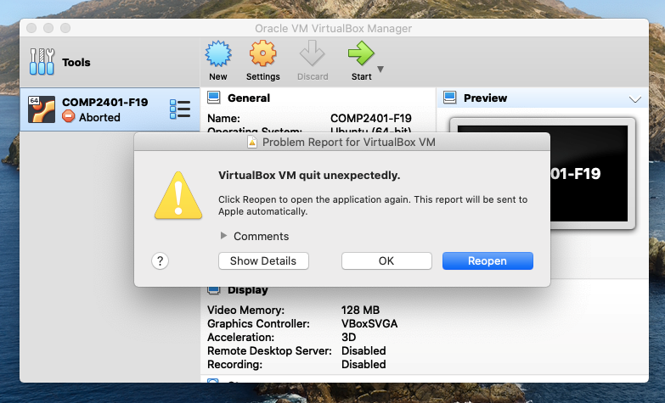
Issues Installing DEVASC-LABVM macOS environment
VirtualBox on macOS environment.
The issue is happening after installing de virtual machine:
New installation of VirtualBox on macOS will install successfully but attempting to run a Virtual Machine could fail.
The solution is to allow Identified Apps to Access the System MacOS. We have to make sure that software by Oracle America, Inc, the current developers of VirtualBox, is permitted to run their software on your system.
cre

Slide 5
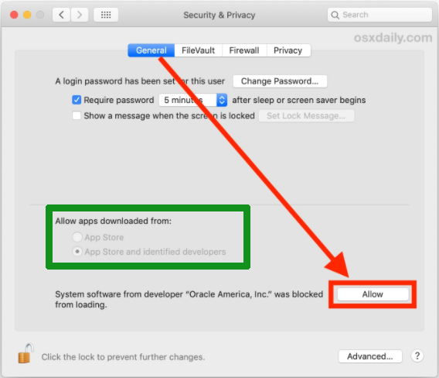
Issues Installing DEVASC-LABVM macOS environment
VirtualBox on macOS environment.
Completely quit out of VirtualBox, later access your Permissions Settings above to get into the General Tab of the Security & Privacy settings window. Unlock the General Tab to permit changes by clicking on the lock icon (password), then in "allow apps downloaded from", make sure App Store and identified developers are selected.
cre

Slide 6
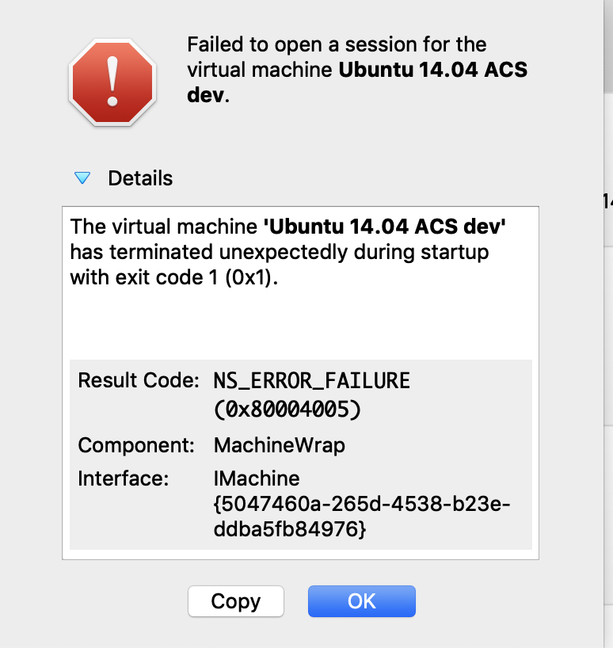
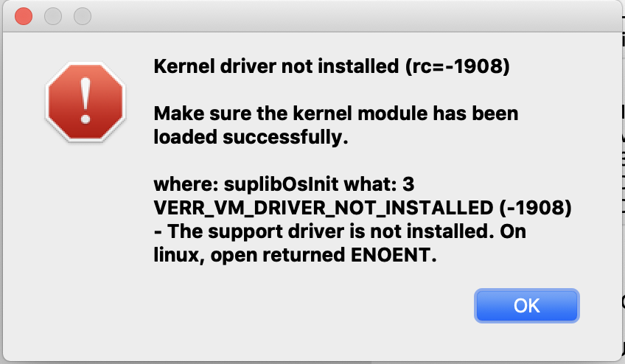
Issues Installing DEVASC-LABVM macOS environment
VirtualBox on macOS environment.
After installing VirtualBox in a MacOS environment and installing the DEVASC-LABVM lab, the following errors may be displayed:
cre

Slide 7
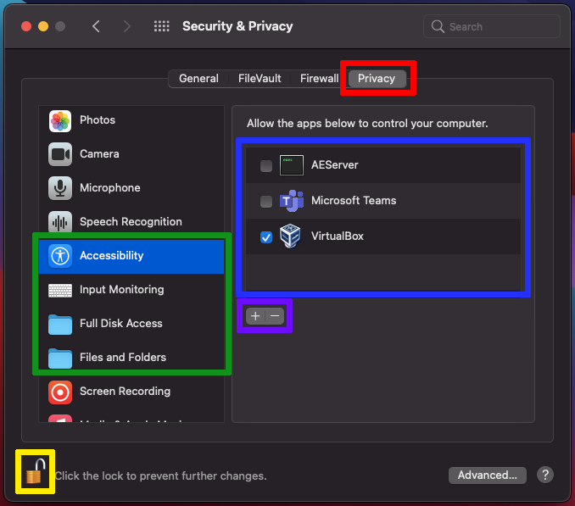
Issues Installing DEVASC-LABVM macOS environment
VirtualBox on macOS environment.
The solution to the previous errors is related to security and privacy permissions. Therefore, permissions must be assigned to the virtual machine in the OS settings. The solution to the previous errors is related to security and privacy permissions. Therefore, permissions must be assigned to the virtual machine in the OS settings. In the "accessibility", "input monitoring", "full disk access" and "files and folders” options.
cre

Slide 8
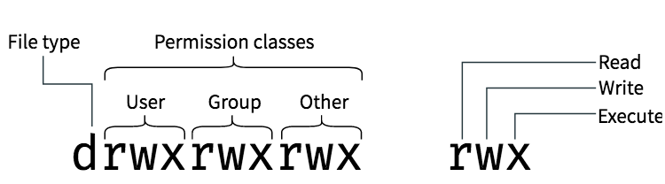
1.2.2 Lab - Linux Review - ILM
To complete the first module 1.2.2 Lab - Linux Review - ILM you might want to check the below link:
Linux File/Directory Permissions cheat sheet: https://www.thegeekdiary.com/linux-file-directory-permissions-cheat-sheet/

Slide 9
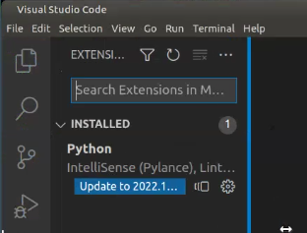
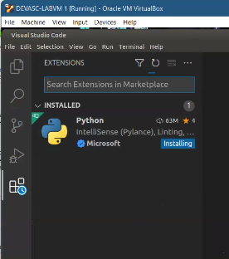
1.3.3 Lab - Python Programming Review - ILM
To complete the first module 1.3.3 Lab - Python Programming Review - ILM you might face bellow error:
syntax error near unexpected token
It is sorted out by updating the Python extension in Virtual Studio Code.
If your code document is not saved as *.py it won’t work.

Slide 10
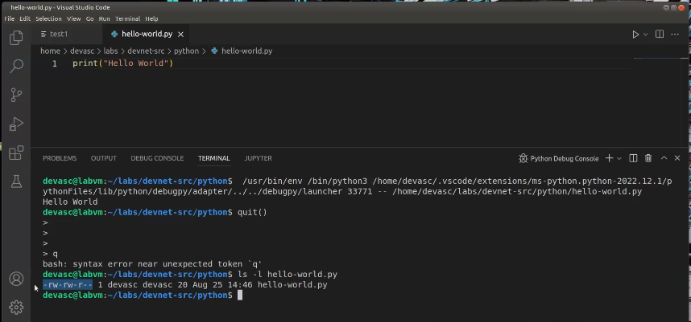
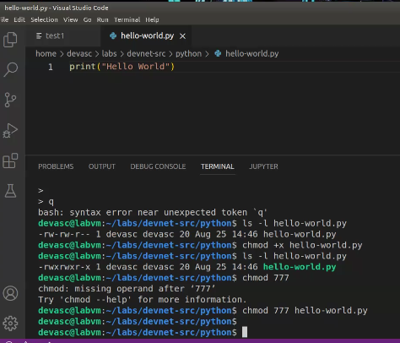
1.3.3 Lab - Python Programming Review - ILM
To complete the first module 1.3.3 Lab - Python Programming Review - ILM you might face bellow error:
In this case, you will need to add –x permissions to the file.

Slide 11
Thank You !!

